Slide 1

Kubernetes Overview
Presented By
Nigel Wardle
CSA CDW

Slide 2
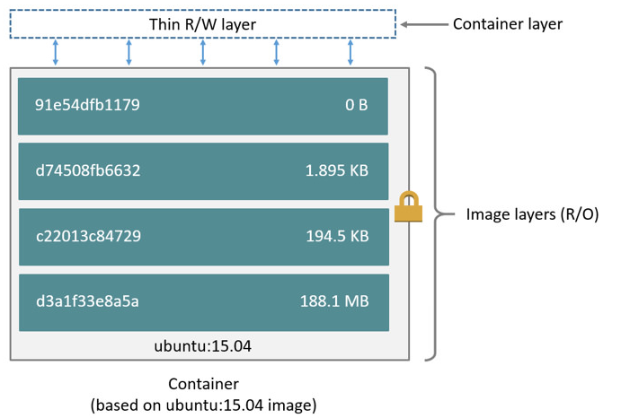
Overview – Why Container?
Extremely portable – cloud agnostic
5 x times -monolithic containers compared to VM
Apps 15 years old can be containerised
Very high take up
Writable layer overlaying read only Docker Image
Contains application code, runtimes and OS files
Uses shared Linux or Windows 2019 kernel

Slide 3
Overview – Why Orchestration?
At scale, we run into complexity
How do I launch my containers onto one or more Docker Hosts?
How do I choose which host to launch it on?
How do I ensure that host has sufficient resources?
How do I ensure the desired state of my containers/apps?
Orchestration manages these things
Even today some companies are using home-grown orchestrators that they built up in the early days of containerization (technical debt… hard to move off)
But those who are moving are overwhelmingly choosing Kubernetes
Different orchestrators have different features and strengths

Slide 4
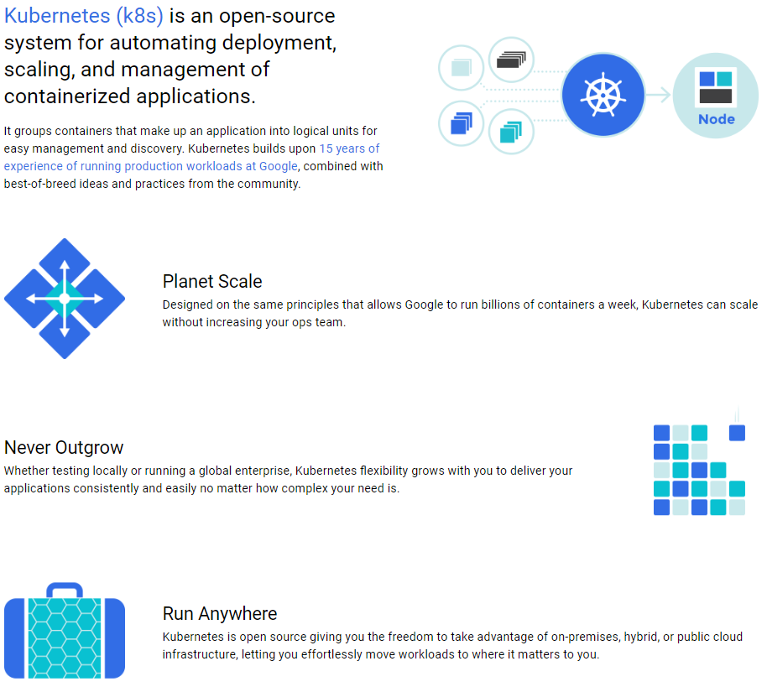





Kubernetes – Run Containers Anywhere
GCP
Notes:
K8

Slide 5
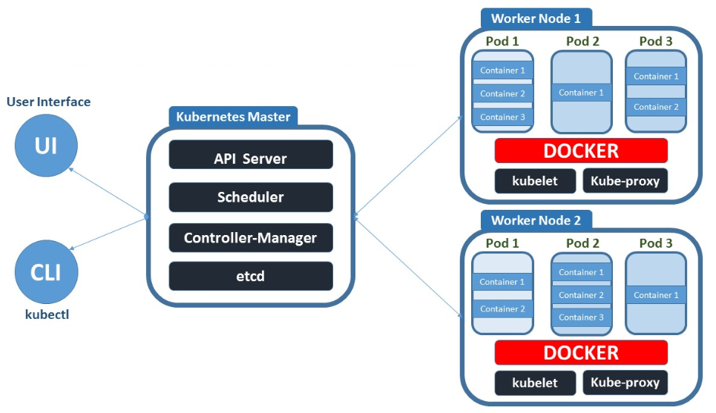
Kubernetes Architecture Overview
x3
Notes:
The heart of K8 is the Master Server which hosts the Control Plane …
A production setup should include a load balanced Multi Master cluster of at least 3 Servers.

Slide 6
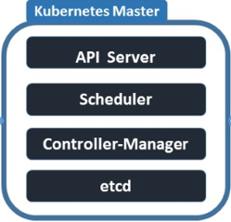
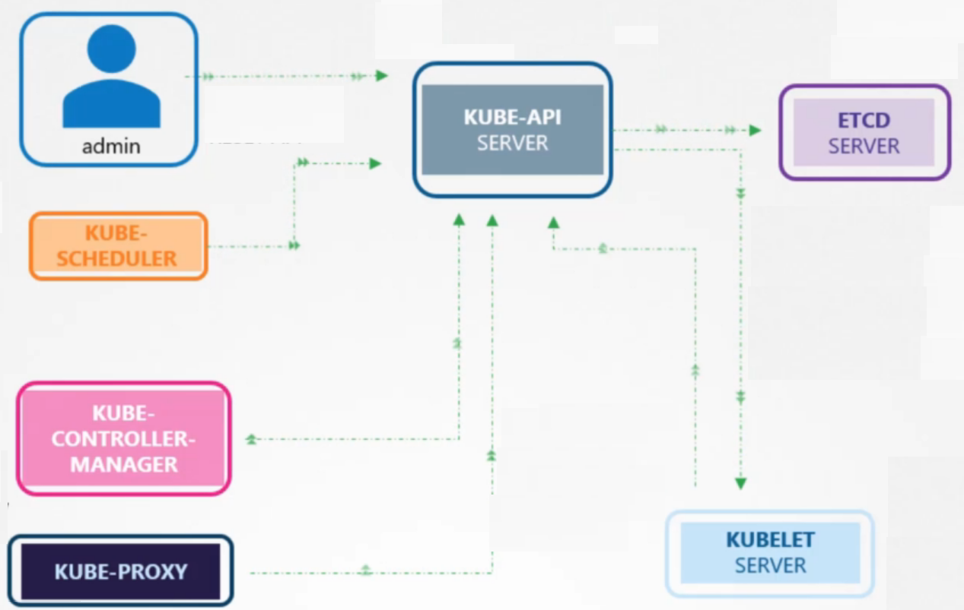
Master Control Plane – Kube API Server
Exposes all traffic to API via Https REST/TLS
Almost all internal traffic is with Kube-API Server

Slide 7
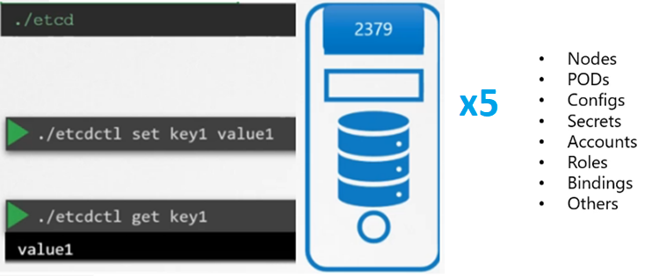
EtcD Cluster – ‘replicated system key-value store’
Backing store for all cluster objects (state)
Production: 5 copies for HA recommended
Manual Installation: Download and install binaries
Kubeadm: installs as containers in Pods
Notes:
EtcD is a linux Daemon that hosts a key value pair database. This database stores the configuration of the K8 system. Requires minimum of 3 copies for HA (5 recommended). Kubeadm installs as a pod in kube-system namespace

Slide 8
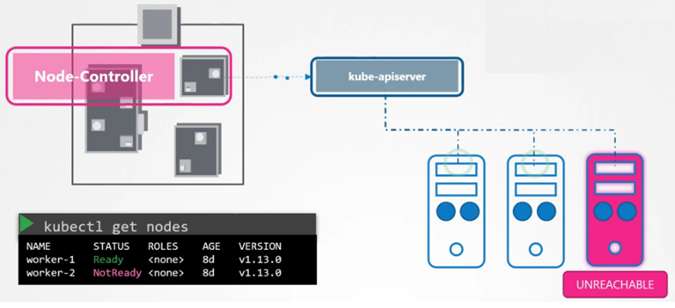
Kube Controller Manager – ‘monitor the system’
Node Controller – notices and responds to node failures.
Replication Controller – maintains the correct number of pods
Endpoints Controller – populates the Endpoints objects
Service Account (SA)
Token Controllers

Slide 9
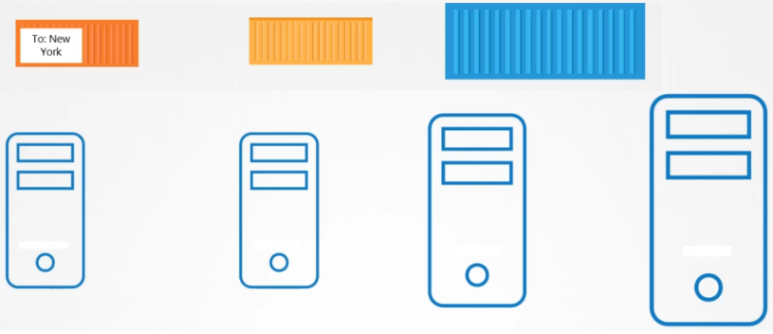
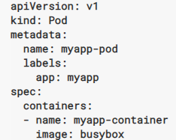
Kube Scheduler – ‘only chooses node for pod’
When a POD key/value is added to EtcD, the scheduler tries to find a worker node with available resources and other matching criteria. When found the node, Kubelet creates the POD on the worker node

Slide 10
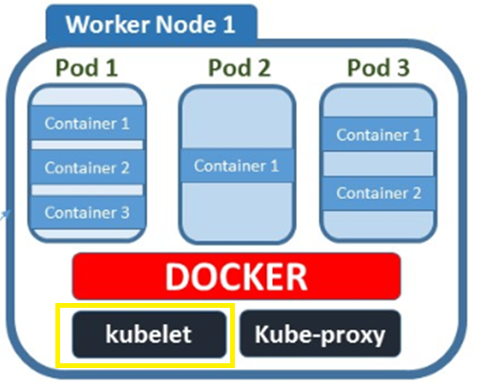
Kubelet: Nodes->Pods->Ephemeral Containers
Kubelet creates POD on worker node, hosting one or more containers
Kubelet downloads image from image registry
Sends health reports about each POD/container.

Slide 11
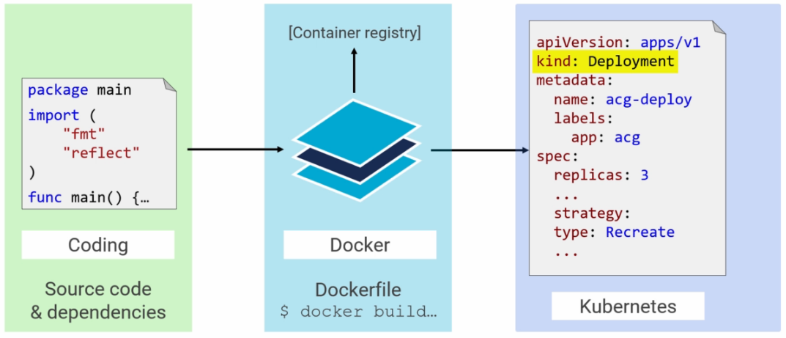
Code->Image->Registry->Deployment

Slide 12
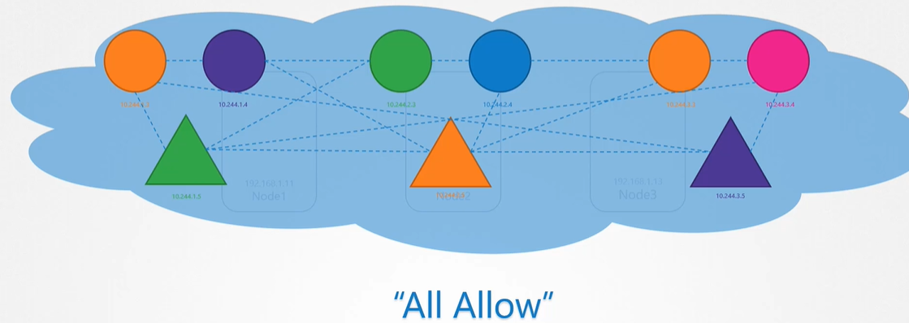
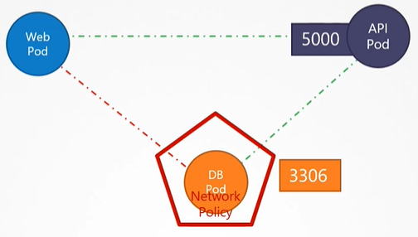
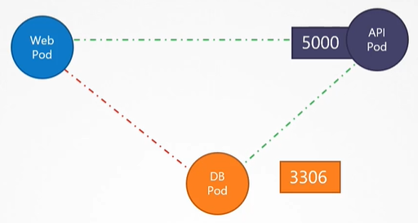
Network Security – All Allow Default – then a Policy

Slide 13
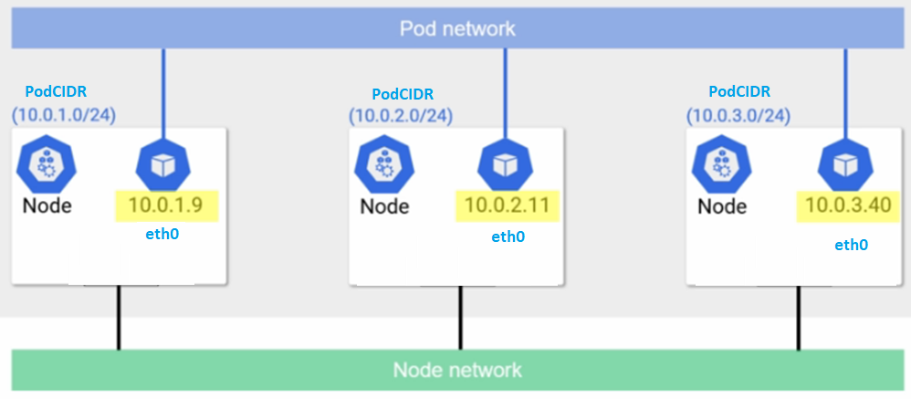
Container Networking Interface (CNI)
What does K8s and CNI achieve?
All nodes can talk to other nodes
All pods can talk to other pods
No NAT
How does CNI do its thing?
Kubelet continuously scans for a CNI file on disk
Runs a Daemon on each node to manage PodCIDR
Runs CNI binary that..
Creates pod eth0 interface – connect pod to network
Allocation PodIP (from PodCIDR)
Make PodIP reachable from whole cluster

Slide 14
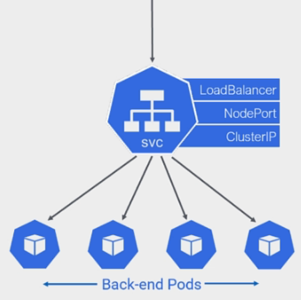
Services – ‘find pod(s) reliably’
Services expose pod(s) reliably
Load balance to replicated pods
Access through IP or DNS name
5 x microservices = 5 x services
ClusterIP for internal
NodePort for external
LoadBalancer uses ‘Cloud’ resources

Slide 15
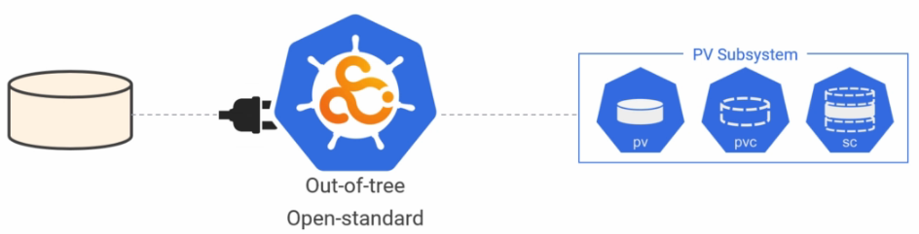
Container Storage Interface (CSI)
CSI: Standard interface for back end storage – on premise/cloud
Each vendor writes CSI compliant plugin

Slide 16
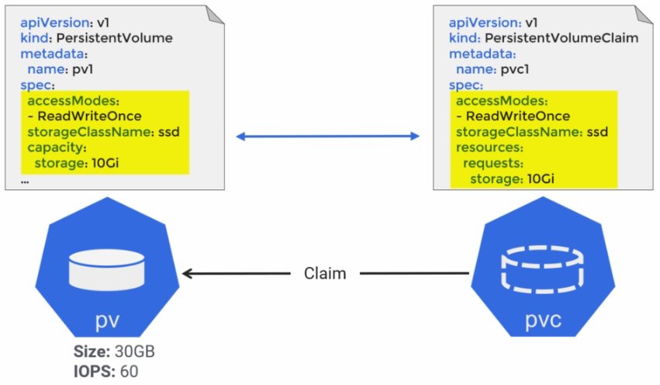
Pods->PVC->PV
Pod references Persistent Volume Claim (PVC)
PVC references Persistent Volume (PV)
Decouples Pods from storage (more portable)

Slide 17
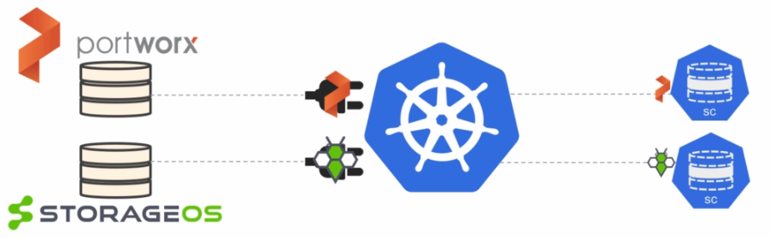
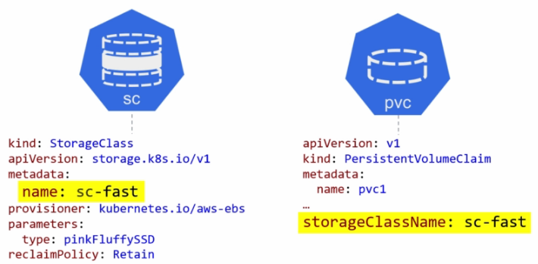
Storage Classes – ‘Dynamic Provision of PV’
PVC dynamically creates PV from SC

Slide 18
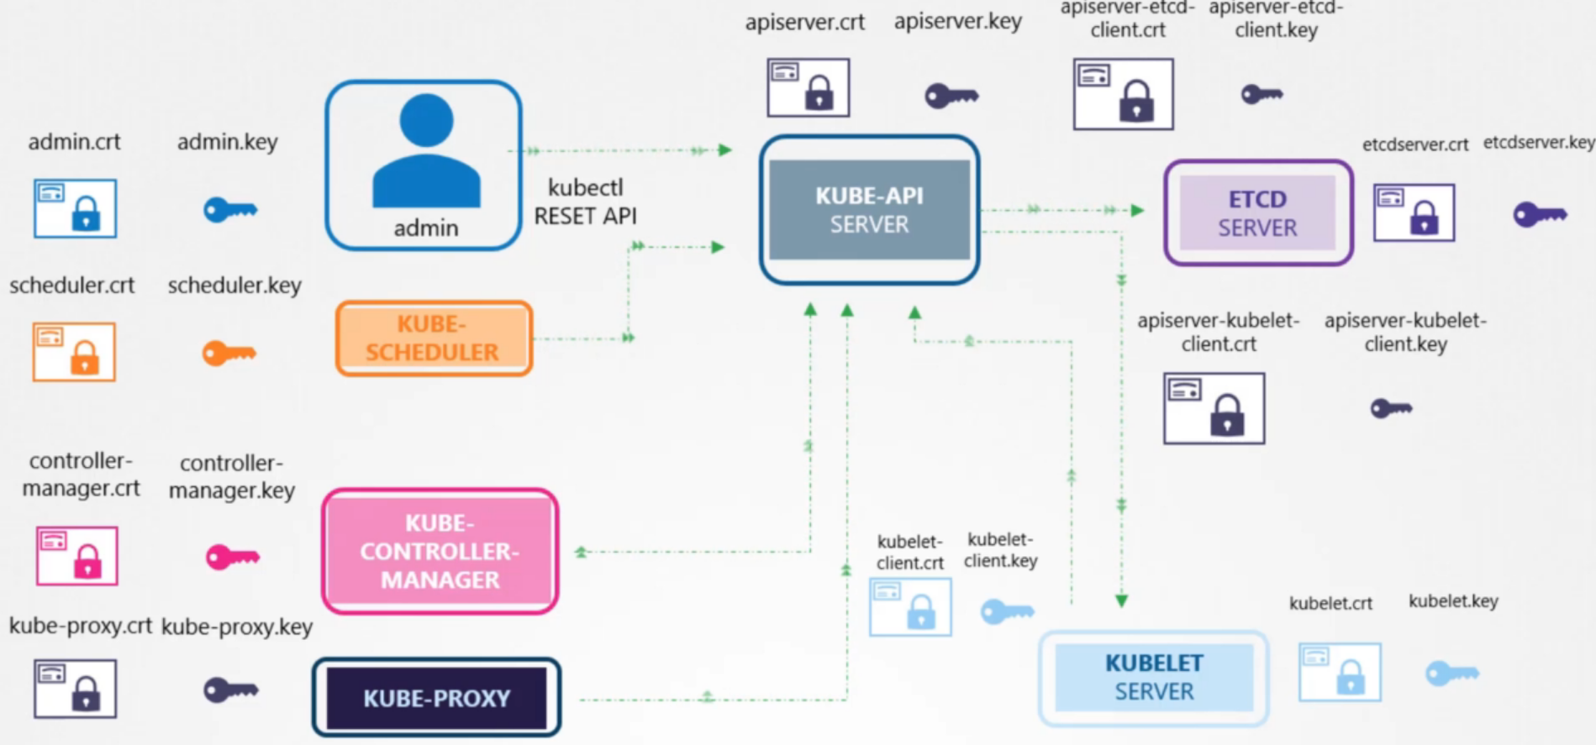
Internal Network Security – lots of Certificates-1

Slide 19
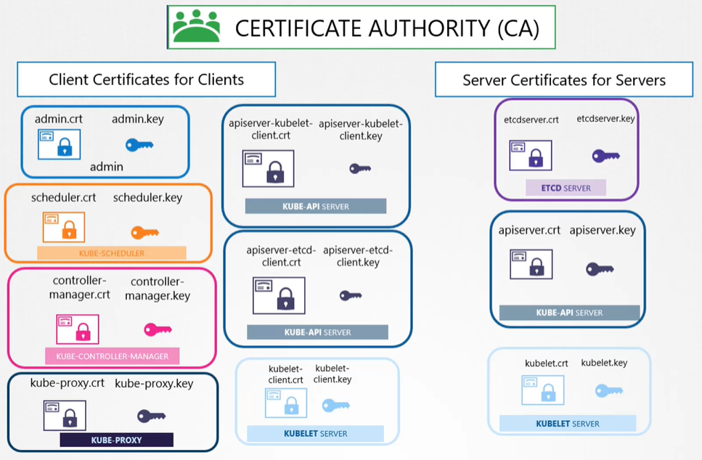
Internal Network Security – lots of Certificates-2

Slide 20
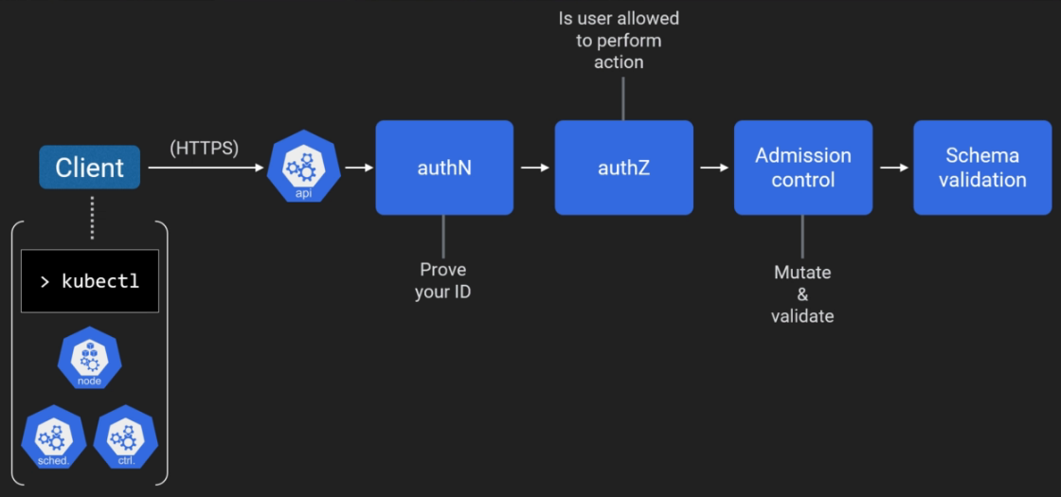
Security – Authentication, Authorisation…

Slide 21
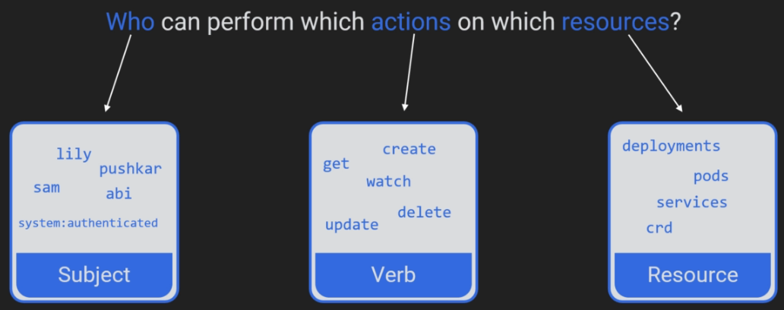
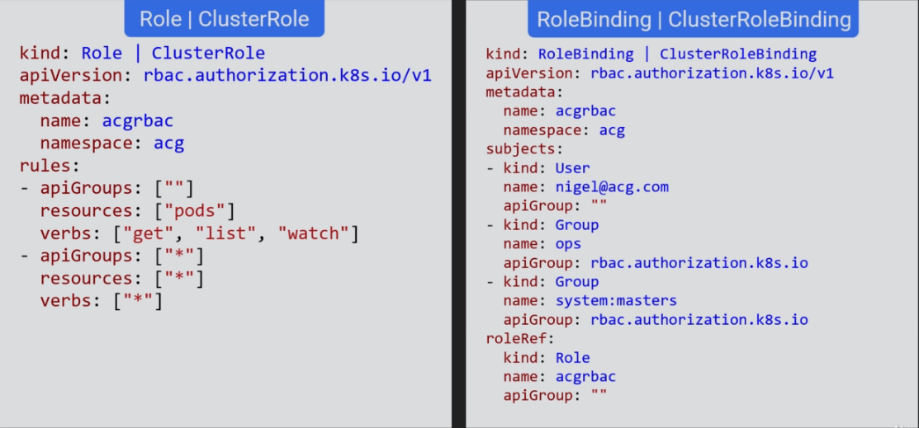
RBAC – Authorisation

Slide 22

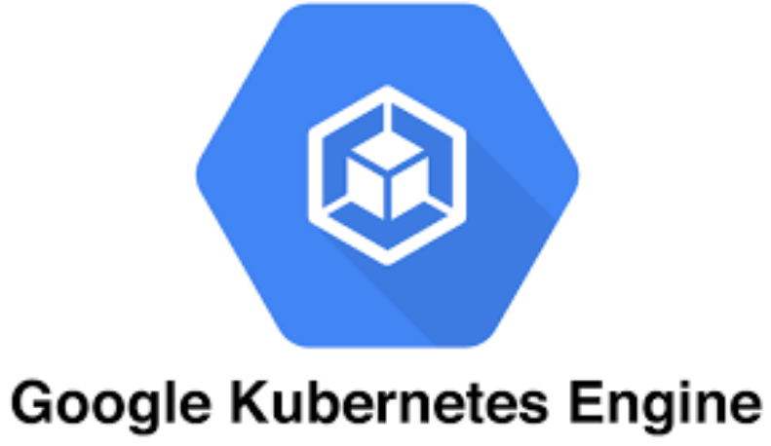
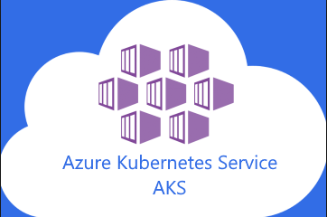

Managed Kubernetes (Master)

Slide 23
Kubernetes Overview
Presented By
Nigel Wardle
CSA CDW

